Slide 1
Eif4g3 Project
June 4, 2015

Slide 2
Outline
Expression estimation
Hspa2 and genes concord with Hspa2
Differential between polysomic WT and MT
Differential RBP binding to the C3H and MT Eif4g3 transcripts
Close look at the W3PLM sample
Differential between non-polysomic WT and MT
Hspa2 mRNA-binding proteins at the 3’ UTR
Eif4g3- and Hspa2-binding proteins
DNA motif-based master regulators
Eif4g and heat shock protein gene families
Spermatogenesis genes and pathways

Slide 3
Hspa2 mRNA expression
Significant up-regulation in the non-polysomic fraction
Three times variation in the wild type polysomic samples
Is the W3PLM variation only on Hspa2, or instead a more general phenomena?

Slide 4
Hierarchical clustering samples
Polysomic samples group together, while differences between IN and NONP samples are small
This suggests NONP signals dominate the total signal (IN)
W3PLM and M3PLM samples are clearly separately from the other 4. Batch effect?
W3PLM is generally different from W1PLM and W2PLM, not only on Hspa2
What are the most strong signal that cause the difference?

Slide 5
W3PLM sample
Take only W1PLM, W2PLM, W3PLM
Filter genes: maximum bigger than 50
Log2 fold change bigger than 0.5 (41% up or down changes)
Up: 202 (Hspa2)
Down: 201
KEGG (up): Pyruvate metabolism (3), Valine, leucine and isoleucine biosynthesis (2), Ribosome (4), Dorso-ventral axis formation (2), Parkinson's disease (3), Glycolysis / Gluconeogenesis (2)
KEGG (down): Pathways in cancer(8), Wnt signaling pathway (5), Chagas disease (American trypanosomiasis) (4), Bacterial invasion of epithelial cells (3), Adherens junction (3), Alanine, aspartate and glutamate metabolism (2)

Slide 6
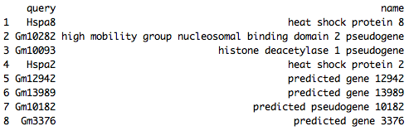
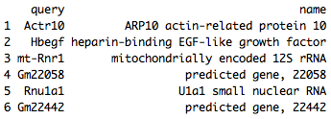
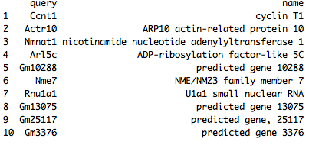
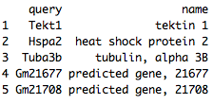
Genes follow the Hspa2 pattern (p < 0.05)
Differential genes in the Non-polysomic fraction
Differential genes by normalizing the polysomic to the non-polysomic fraction

Slide 7
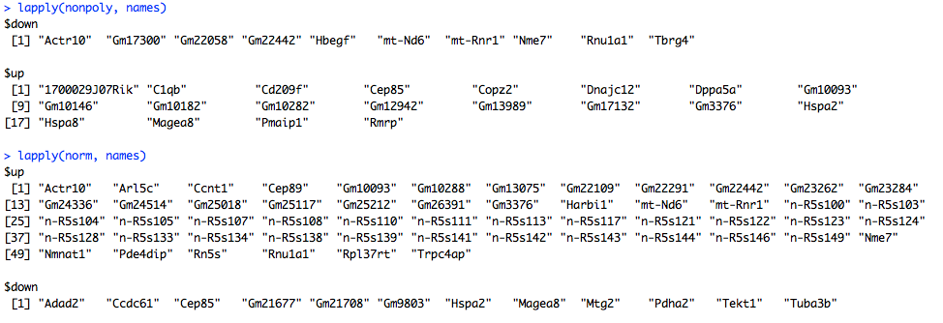
Genes follow the Hspa2 pattern (p < 0.1)
Differential genes in the Non-polysomic fraction (p-value < 0.1)
Differential genes by normalizing the polysomic to the non-polysomic fraction (p-value < 0.1)

Slide 8
Link Eif4g3 mutation to Hspa2 phenotype
RNA-sequencing
Polysomic mRNA
Non-polysomic mRNA
Polysomic to non-polysomic
External
RNA-binding protein (CISBP-RNA)
Protein-protein interaction database (STRING)
Spermatogenesis genes (GO)

Slide 9
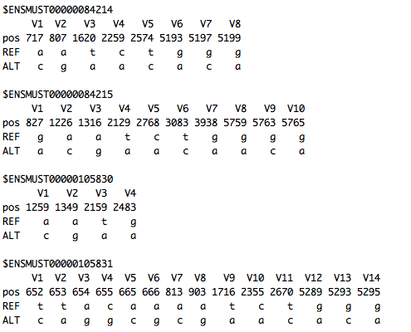
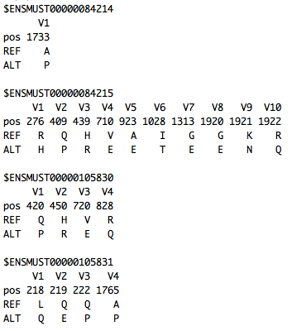
SNPs in the gene level and missenses in the protein level
Motif-based RBP-binding estimation tells how RNA-binding proteins (RBP) interact differently with WT/MT Eif4g3 mRNA

Slide 10
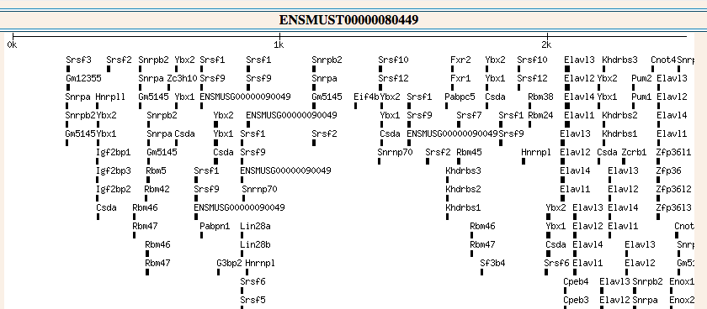
Eif4g3 mRNA RBP
RBP interact differently with WT/MT Eif4g3 mRNA (8): Raly, Hnrnpc, Tial1, Lin28a, Sart3, Pabpc1, Pabpn1, Srsf2 (position-wise or sequence wise, RBP expression high).
Prbpc1 is up-regulated in MT polysomic samples, as opposed to WT polysomic samples
Shared with Hspa2 mRNA RBP: Raly, Hnrnpc, Tial1, Lin28a, Pabpn1, Srsf2 (red: 3’UTR).
Would the differential use of RBP at Eif4g3 mRNA affect its function in Hspa2 mRNA translation? Not likely given Eif4g3 is most interesting at the protein level.

Slide 11
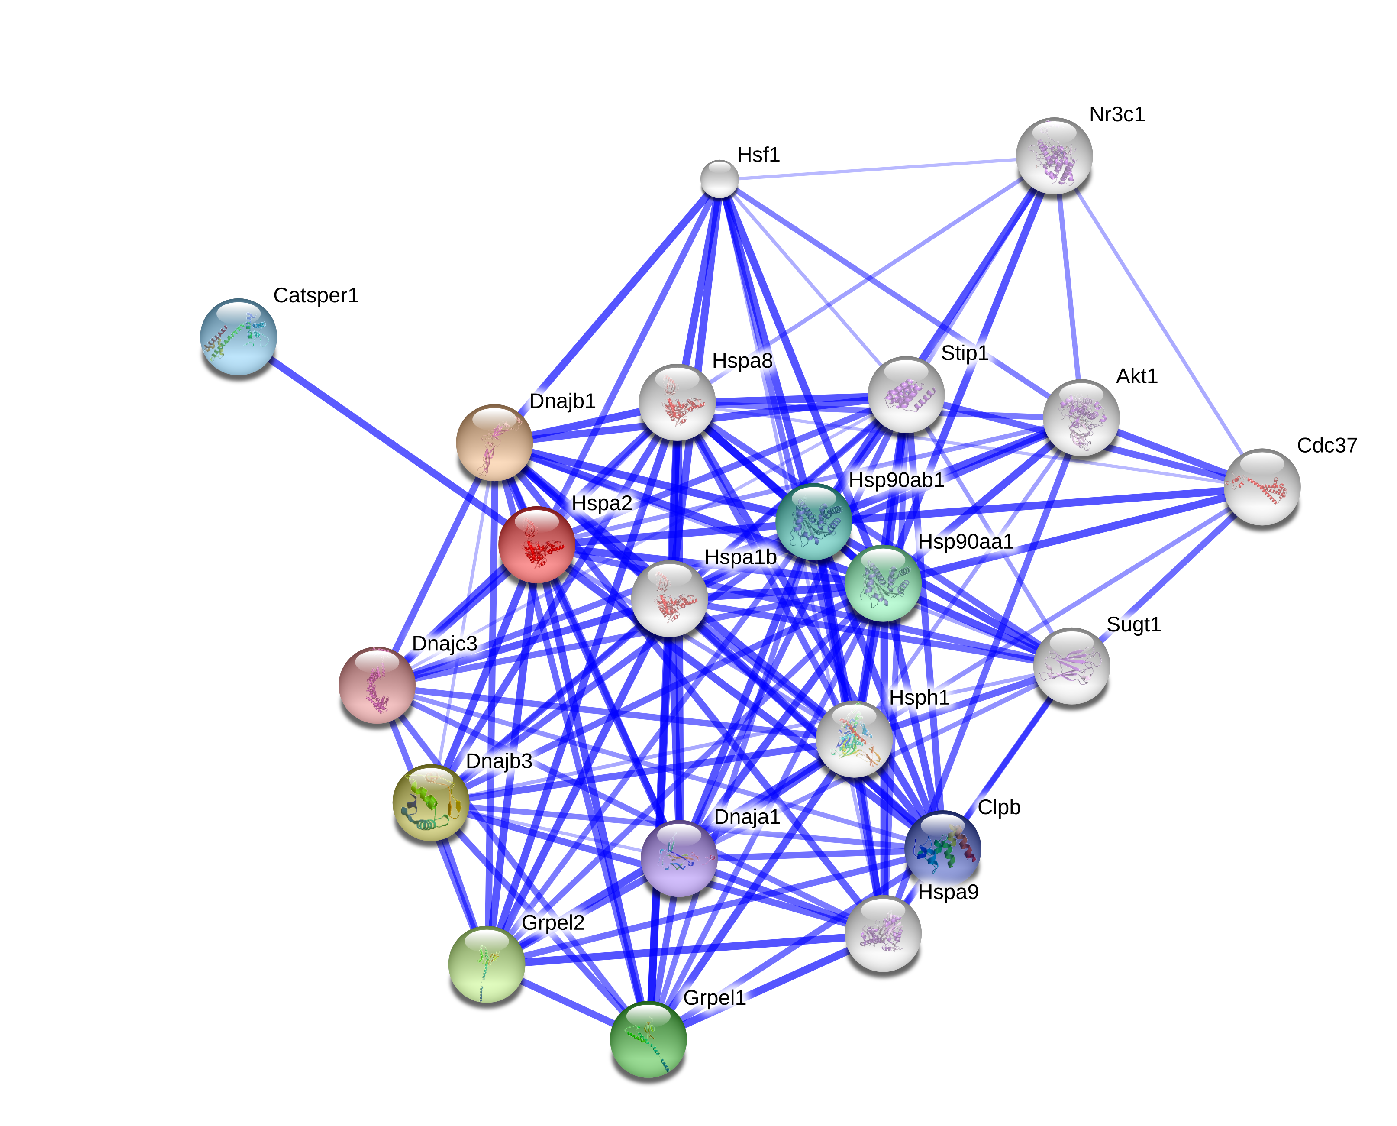
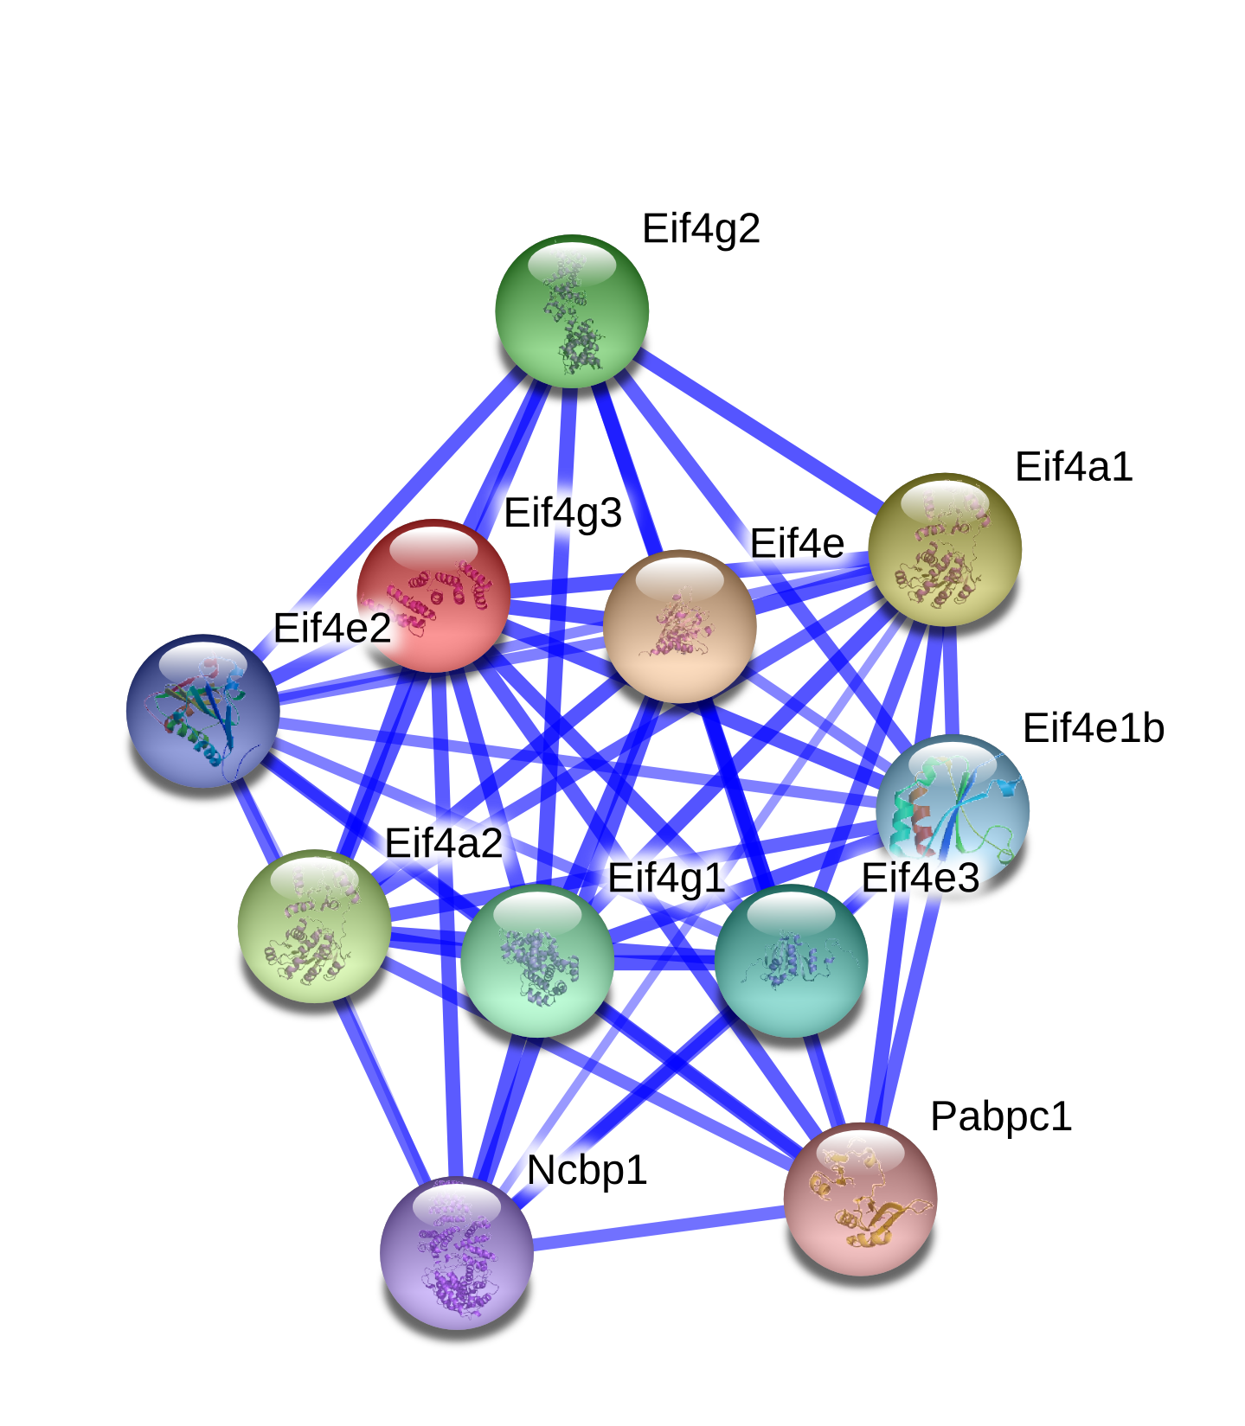
Protein interaction (STRING)
No shared Eif4g3- and Hspa2-binding proteins
Eif4g3-binding proteins show polysomic up-regulation: Eif4e and Pabpc1
Hspa2-binding proteins show polysomic up-regulation: Dnaja1, Hsp90aa1, Hsp90ab1, Hspa8, Hspa9, Hsph1, Stip1
Hspa2-binding proteins show non-polysomic up-regulation: Hspa8
Pabpc1 (mRNA up-regulated in the polysomic fraction, differential use by WT/MT Eif4g3 mRNA) is also a Eif4g3-binding protein.

Slide 12
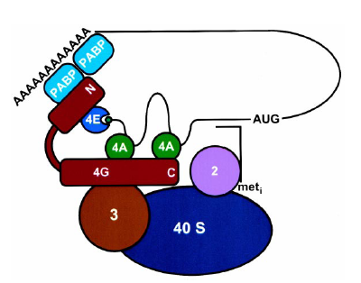
Hspa2 mRNA RBP and 3’UTR
Hspa2 mRNA RBP show polysomic up regulation: Snrpb2, Rbm46, Rbm5, Srsf1, Srsf10, Khdrbs1, Fxr1
Hspa2 mRNA 3’UTR RBP show polysomic up regulation: Snrpb2, Rbm46, Khdrbs1

Slide 13

Shared RBP at Hspa2 concord gene’s 3’UTR
Differential genes in the Non-polysomic fraction (p-value < 0.1)
25 transcripts of the 20 non-polysomic up regulation genes -→ mRNA 3’UTR sequence -→ RBP -→ overlaps with the 24 Hspa2 mRNA 3’UTR RBP

Slide 14
Summary
Eif4g3 mRNA sequences in WT/MT
Eif4g3 peptide sequences in WT/MT
How the peptide differences affect protein interaction?
RBP that bind with Eif4g3 mRNA (WT/MT) differently (8)
Pabpc1 show polysomic difference
Shared with Hspa2 mRNA RBP (6 in total, 3 at 3’UTR)
Given Eif4g3 functions at the protein level. Not likely interesting.
Eif4g3 protein-binding proteins show polysomic differences (2)
Eif4e and Pabpc1
Hspa2 protein-binding proteins show polysomic differences (7)
Hspa2 protein-binding proteins show non-polysomic differences (Hspa8)
Hspa2 mRNA RBP show polysomic difference (7)
RBP bind at Hspa2 mRNA 3’ UTR (24)
Polysomic up regulation: Snrpb2, Rbm46, Khdrbs1
Shared with 25 mRNA show non-polysomic up-regulation

Slide 15
Hspa8 mRNA expression
This gene encodes a member of the heat shock protein 70 family, which contains both heat-inducible and constitutively expressed members. This protein belongs to the latter group, which are also referred to as heat-shock cognate proteins. It functions as a chaperone, and binds to nascent polypeptides to facilitate correct folding. It also functions as an ATPase in the disassembly of clathrin-coated vesicles during transport of membrane components through the cell. Alternatively spliced transcript variants encoding different isoforms have been found for this gene.

Slide 16
Eif4e mRNA expression
The protein encoded by this gene is a component of the eukaryotic translation initiation factor 4F complex, which recognizes the 7-methylguanosine cap structure at the 5' end of cellular mRNAs. The encoded protein aids in translation initiation by recruiting ribosomes to the mRNA. Association of this protein with the 4F complex is the rate-limiting step in translation initiation. Three transcript variants encoding different isoforms have been found for this gene.

Slide 17
Pabpc1 mRNA expression
This gene encodes a poly(A) binding protein. The protein shuttles between the nucleus and cytoplasm and binds to the 3' poly(A) tail of eukaryotic messenger RNAs via RNA-recognition motifs. The binding of this protein to poly(A) promotes ribosome recruitment and translation initiation; it is also required for poly(A) shortening which is the first step in mRNA decay. The gene is part of a small gene family including three protein-coding genes and several pseudo-gene.

Slide 18
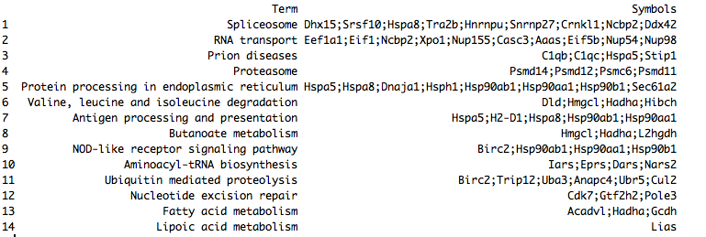

Polysomic only
339 and 84 genes were up- and down-regulated (p-value < 0.05) between the polysomic WT and MT

Slide 19
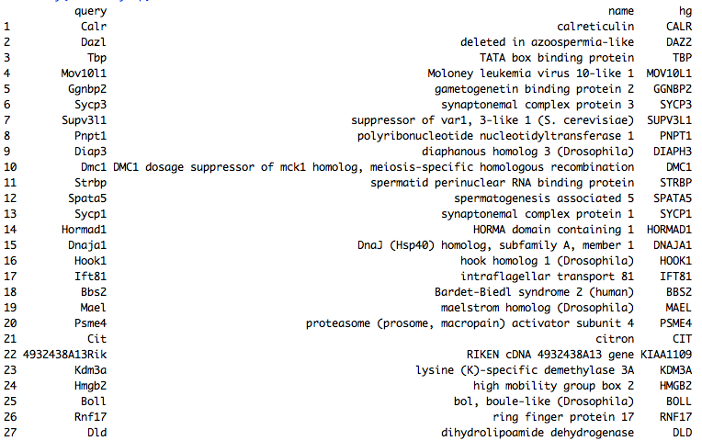
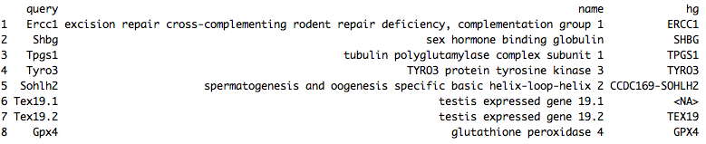
Spermatogenesis genes (GO) with differential polysomic expression

Slide 20
Potential master regulators for up-regulated polysomic mRNA

Slide 21
Potential master regulators for down-regulated polysomic mRNA

Slide 22
Discussion

Slide 23
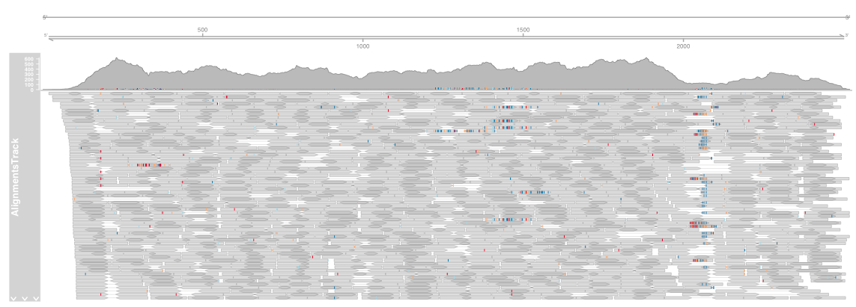
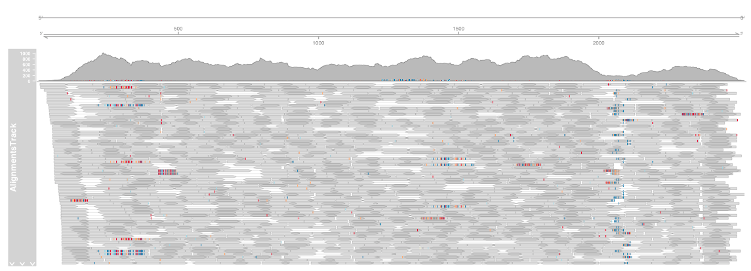
Hspa2 3’UTR differential coverage (No trends)

Slide 24

Shared RBP at Hspa2 concord gene’s 3’UTR
Differential genes in the Non-polysomic fraction (p-value < 0.1)
11 transcripts of the 20 non-polysomic up regulation genes (max TPM > 20) -→ mRNA 3’UTR sequence -→ RBP -→ shared with Hspa2 mRNA 3’UTR RBP

Slide 25

Shared RBP at Hspa2 concord gene’s 3’UTR
Differential genes by normalizing the polysomic to the non-polysomic fraction (p-value < 0.1)
9 transcripts of the 12 non-polysomic up regulation genes (max TPM > 20) -→ mRNA 3’UTR sequence -→ RBP -→ shared with Hspa2 mRNA 3’UTR RBP

